Slide 1

Data Management, Sharing, & Preservation Services
Karl Benedict – Director of Research Data Services & IT
Jon Wheeler – Data Curation Librarian College of University Libraries & Learning Sciences
The Art & Science of Data: From Numbers to Narratives January 15, 2020
This work is licensed under a Creative Commons Attribution 4.0 International License

Slide 2
Outline
Context
The Research and Data Lifecycles
Data Sharing & Demonstrating Impact
File sharing strategies & resources
Data publication & preservation
Notes:
Organization of the discussion of support opportunities into the different support phases provided by OVPR and Departmental research support personnel.

Slide 3
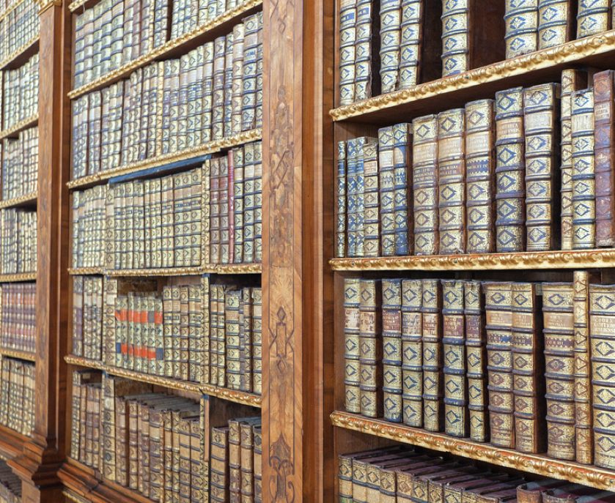
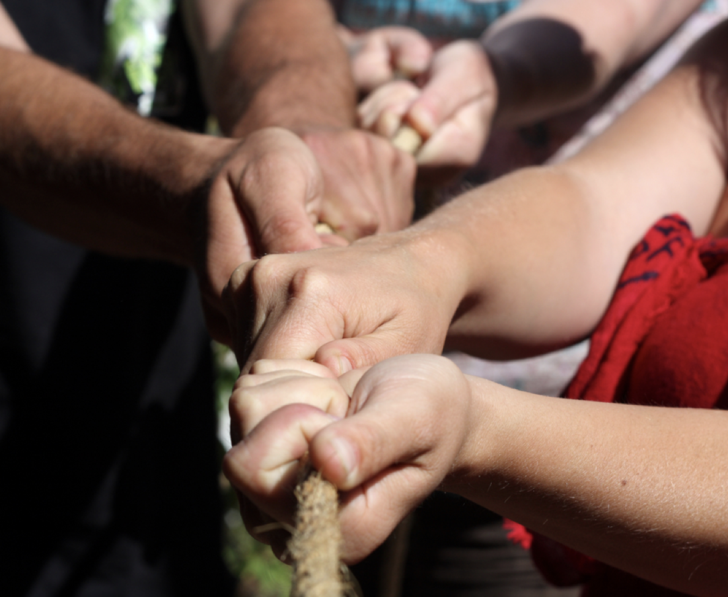


Context
Increased Project Efficiency
Data Management Plans required by funding agencies
Publications requiring links to supporting data
Increasing collaborative research where data must be shared

Slide 4
The Research & Data Lifecycles

Slide 5
Research Lifecycle
Ideas
Partners
Proposal Writing
Research Process
Publication
JISC - http://www.jisc.ac.uk/whatwedo/campaigns/res3/jischelp.aspx

Slide 6
Research Lifecycle
Simulate, Experiment, observe
Manage Data
Analyze Data
Share Data
Ideas
Partners
Proposal Writing
Research Process
Publication
Research
Process
JISC - http://www.jisc.ac.uk/whatwedo/campaigns/res3/jischelp.aspx

Slide 7
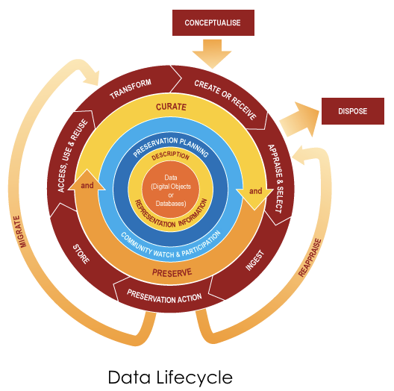
Research Lifecycle
Data Lifecycle
Ideas
Partners
Proposal Writing
Research Process
Publication
Simulate, Experiment, observe
Manage Data
Analyze Data
Share Data
Research
Process
JISC - http://www.jisc.ac.uk/whatwedo/campaigns/res3/jischelp.aspx
DCC - http://www.dcc.ac.uk/resources/curation-lifecycle-model

Slide 8
Research & Data Lifecycles
Proposal Preparation
Project Execution

Slide 9
Collaborative Data Management & Sharing

Slide 10
Collaboration & Sharing Solutions
Library Supported Platforms
Other University Supported Platforms
LoboGit
https://lobogit.unm.edu/
Supports source code development, data collection, data analysis
UNM Digital Repository
https://digitalrepository.unm.edu/
Public open access repository for documents and data
Dryad
https://datadryad.org
Public open access data preservation
LibSafe
Non-public digital preservation for all content types (images, documents, data)
OneDrive
File sharing & collaborative document development for non-sensitive data
SharePoint
Project management & file sharing for non-sensitive data
Secure SharePoint
Project management & file sharing for some sensitive data

Slide 11
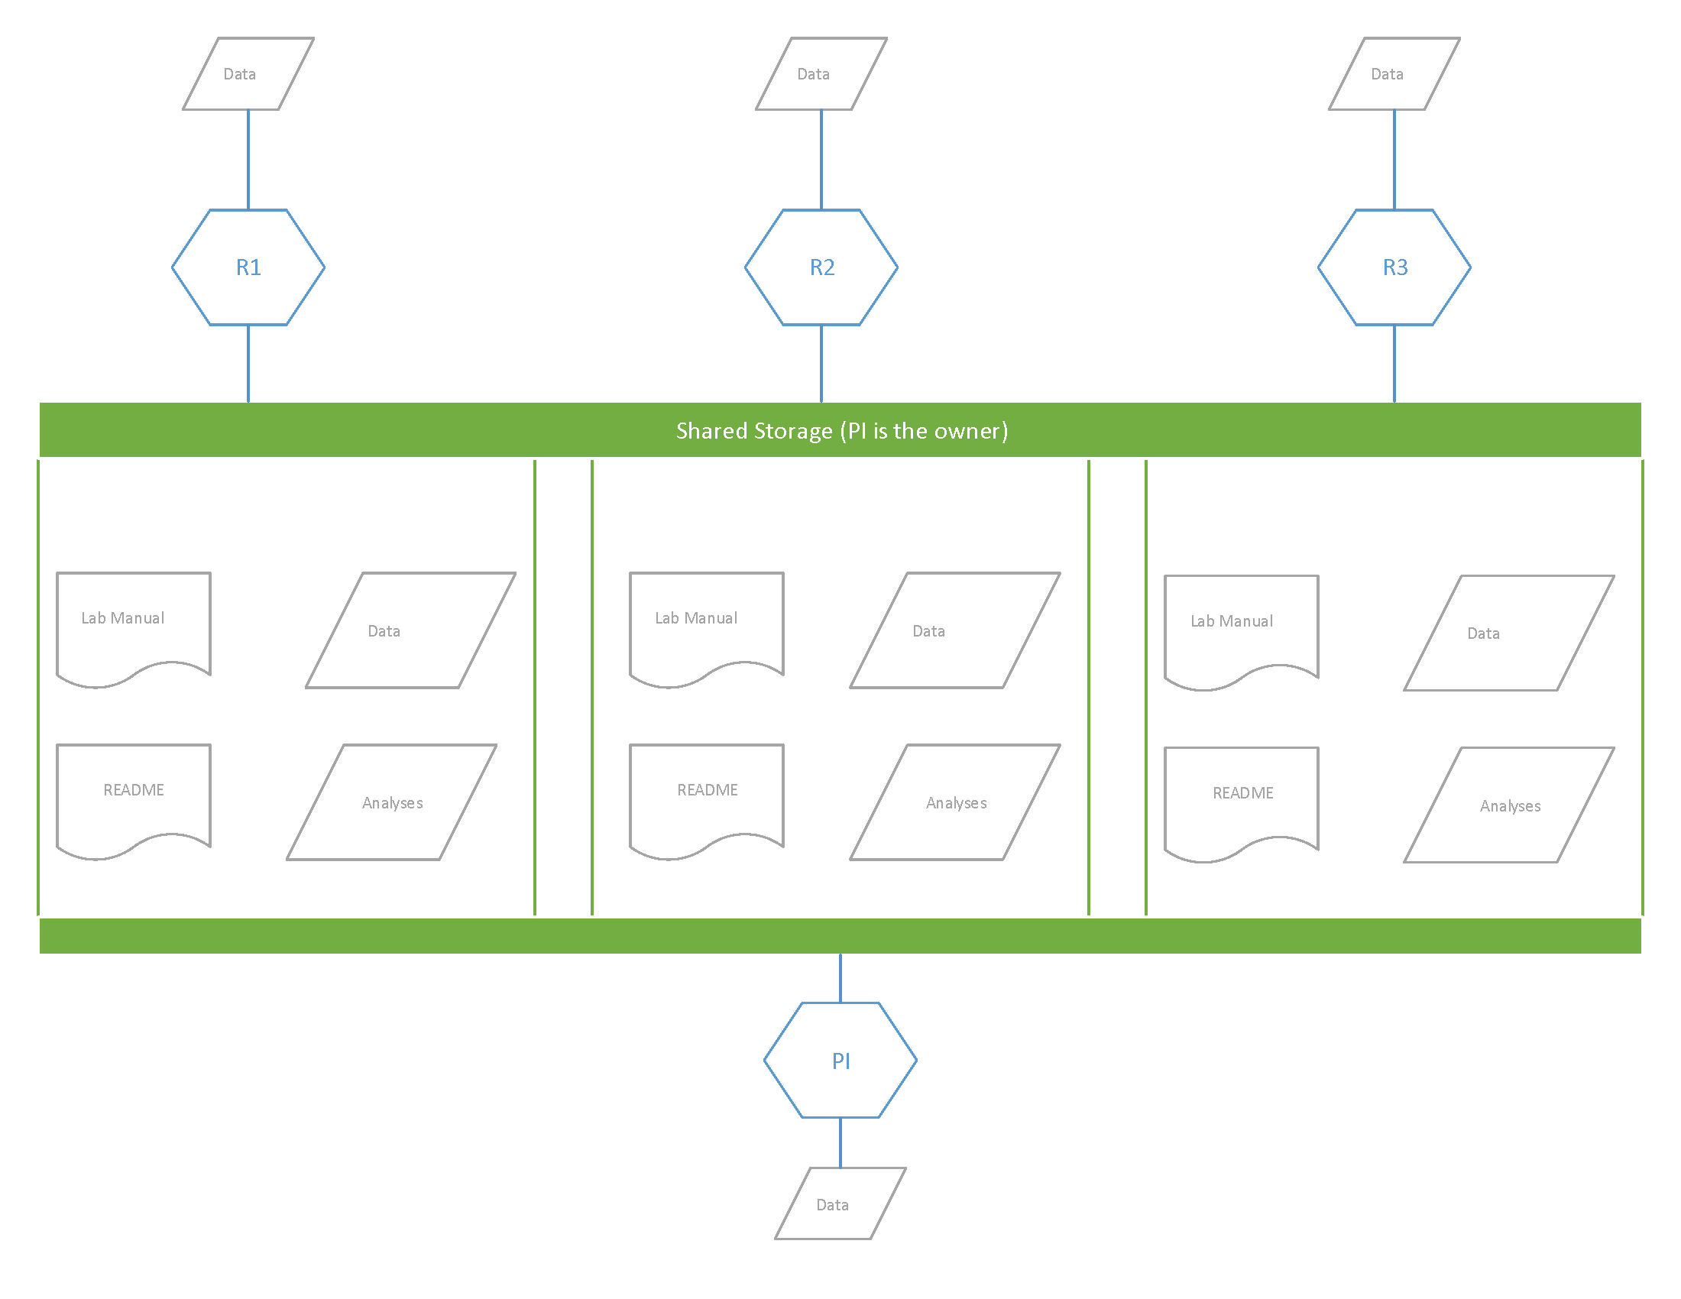
Best Practices
Develop a data management plan documenting
Expected data types & sources
Roles & responsibilities
Backup & preservation strategies
Publication & archiving strategies
Centralize shared file management
Establish project-wide file naming conventions
Verify backups
Share & publish documentation where appropriate

Slide 12
Demonstrating Impact

Slide 13
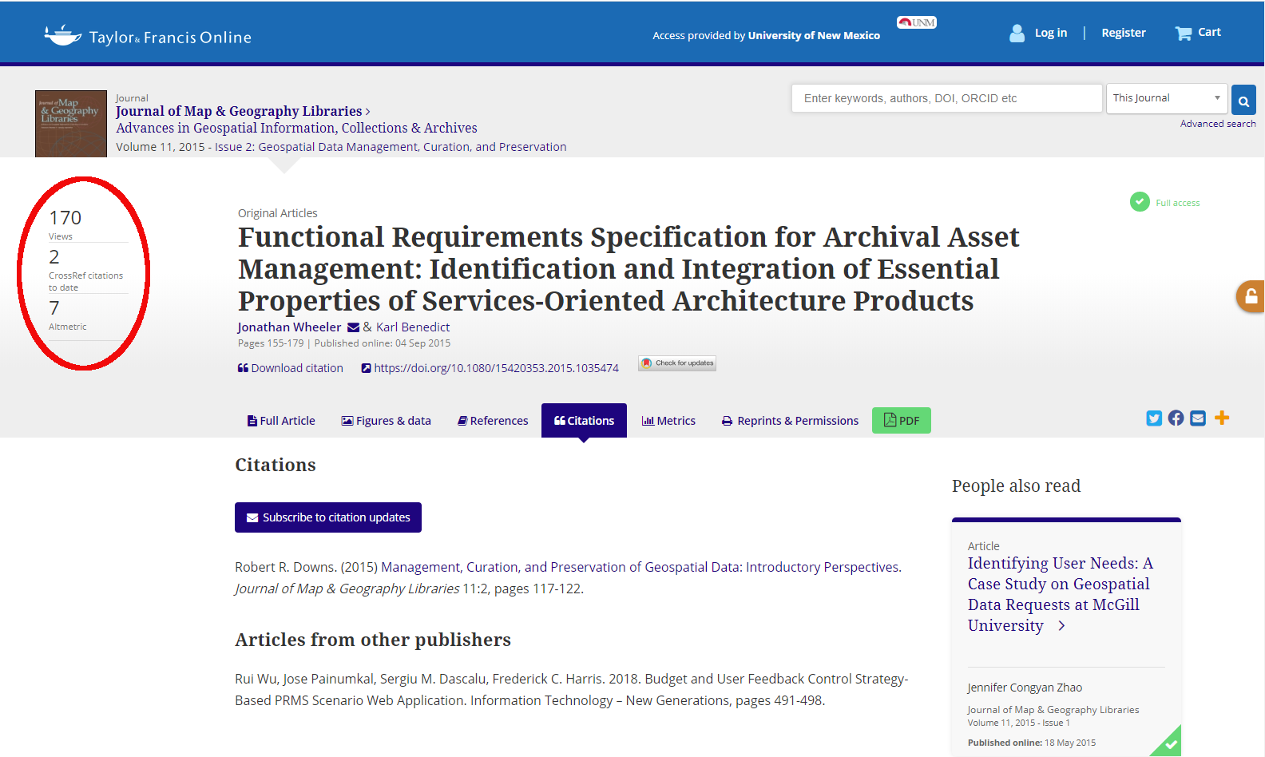

Slide 14
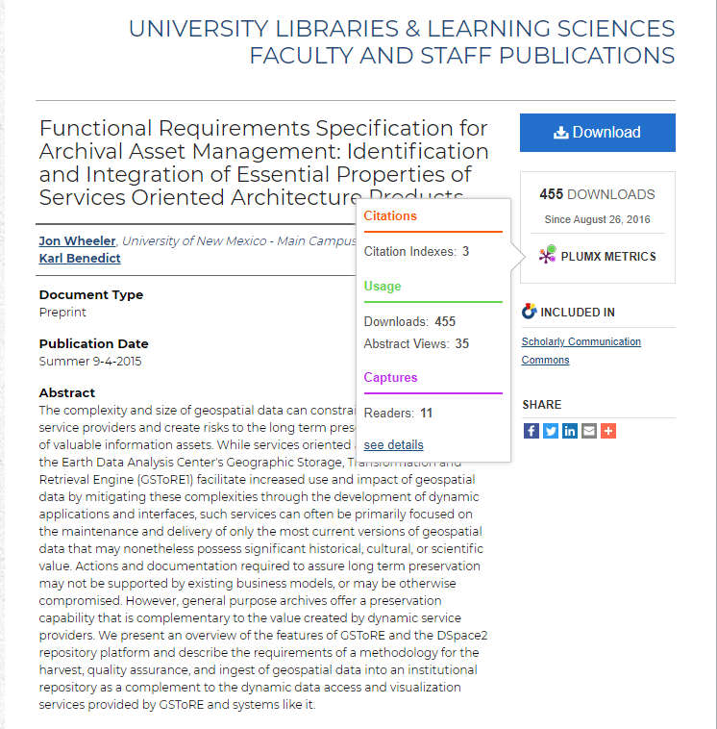

Slide 15
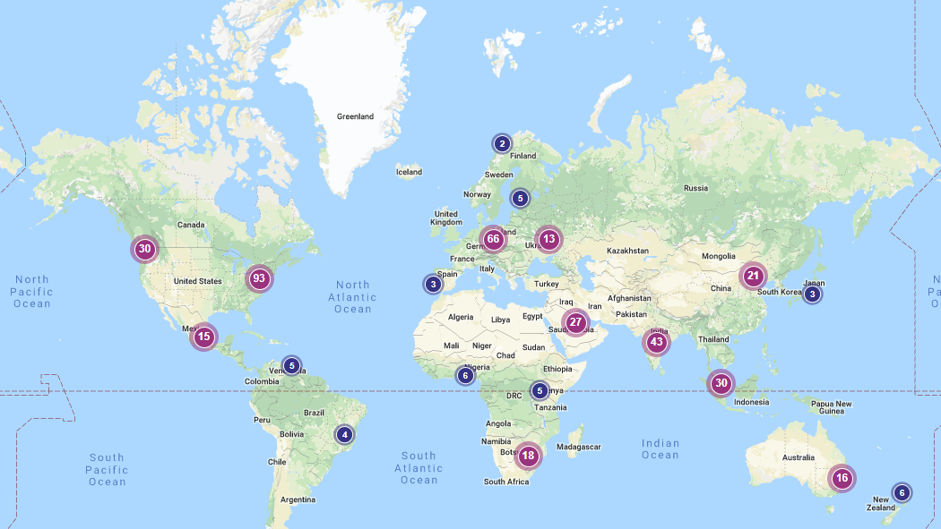
Benefits of Openness
Increased citations and impact
"Open Access Citation Advantage"
Democratize access to information
Other practical benefits include increased transparency, reduced duplication of effort, interdisciplinary applications, etc.
Institutional repository dashboard access map for Wheeler & Benedict, 2015 is shown here.

Slide 16
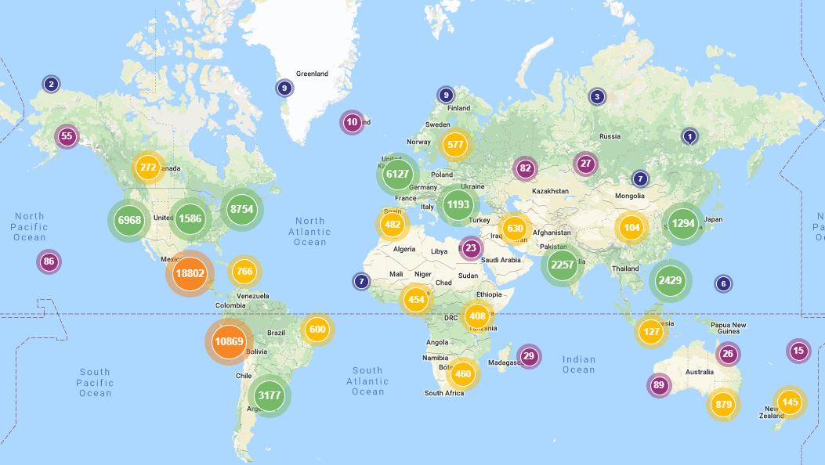
Broader Impacts
Global access to UNM institutional repository content shown.
Granular metrics available for departments, series, individual publications & datasets.

Slide 17
Making Research Accessible
Research Data Services can help:
Identify Shareable Products
Identify Best Fit Repositories
Curate, Document & Publish
Report & Assess Impact

